Slide 1
Collision Avoidance System for UAVs in a Search and Rescue Swarm
By Luke Cowan

Slide 2
Background
Uses of UAVS in a Search and Rescue Environment
Scan for life
Scan infrastructure
Wide scan of an area
Fly in a swarm to cover more ground
Need a Collision Avoidance System

Slide 3
Motivation
Create own CAS
To be implemented on a drone
3D CAS VO not extensively studied
Try to find a new method
Concept of Velocity Obstacles chosen

Slide 4
Aims of the project
Create a CAS in 2D
Create a CAS in 3D
Evaluate the Performances
Investigate possibilities of implementing on to a UAV

Slide 5
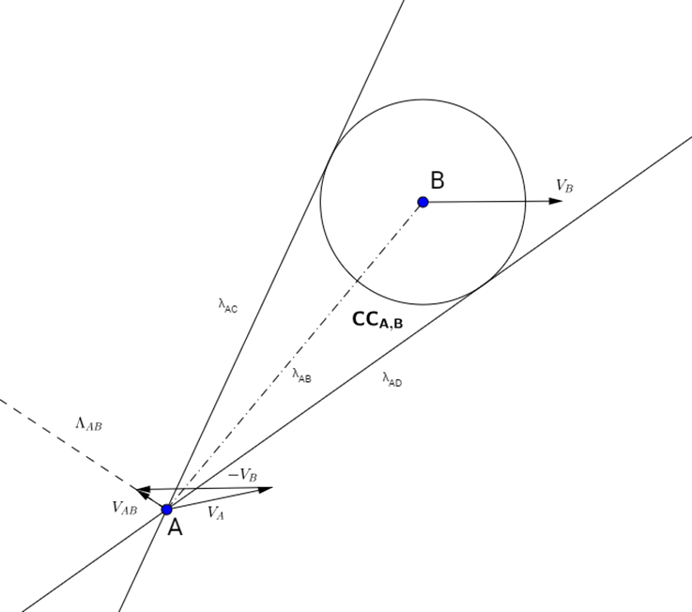
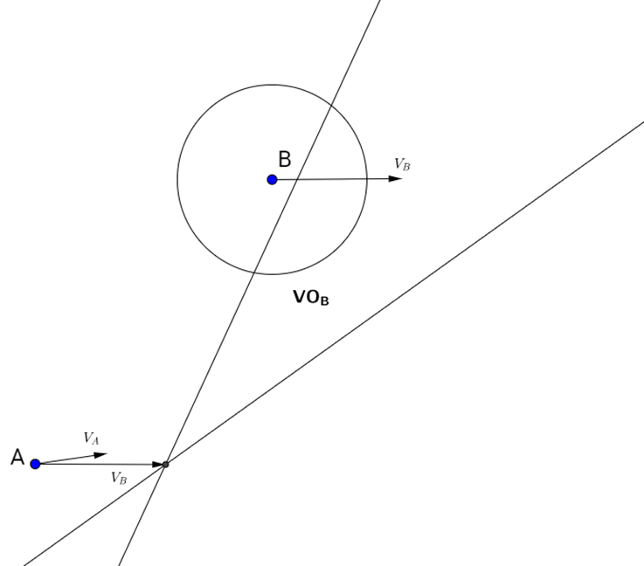
Velocity Obstacle Concept
Collision Cone
Velocity Obstacle
Notes:
Reduce the size of A to a point and increase the size of B by radius of A
Create two tangents to the circle from A
This creates the collision cone

Slide 6
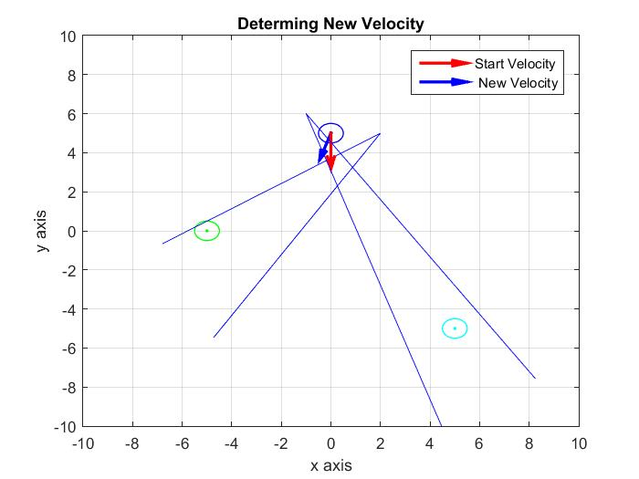
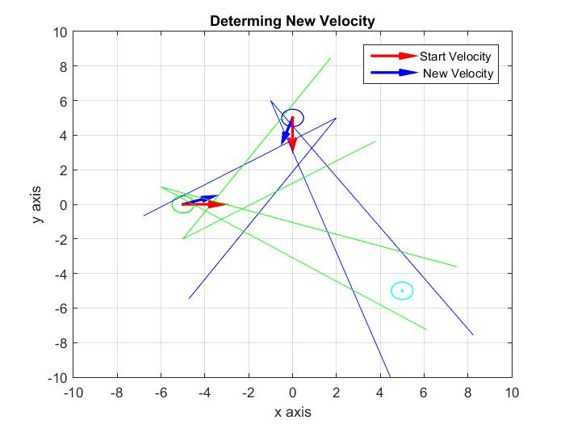
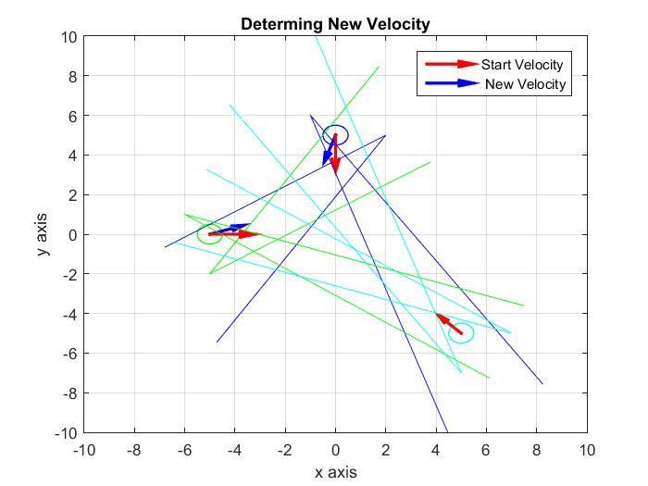
Determining New Velocity

Slide 7
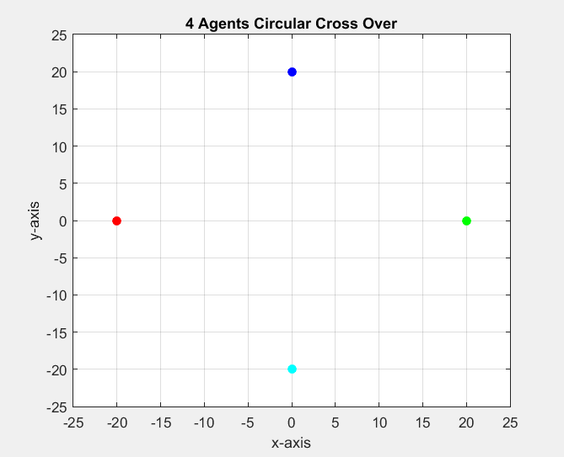
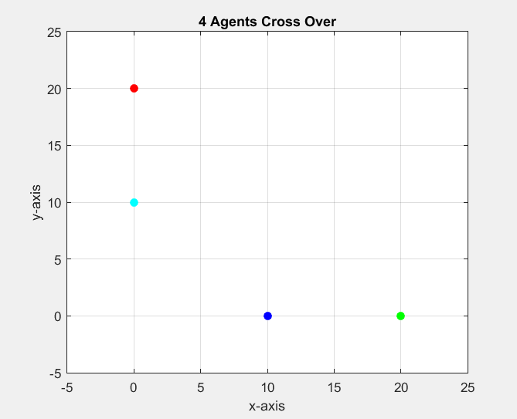
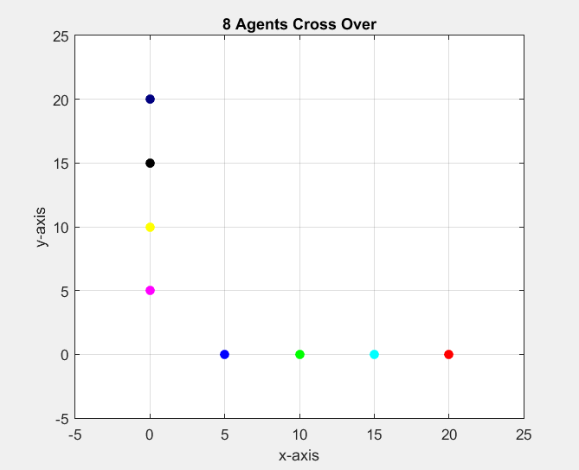
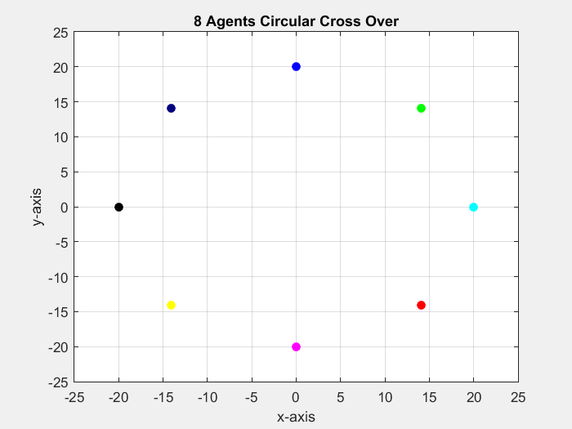
2D Validation

Slide 8
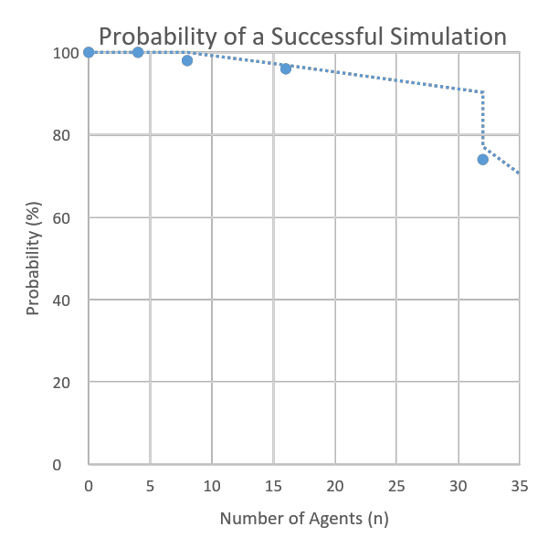
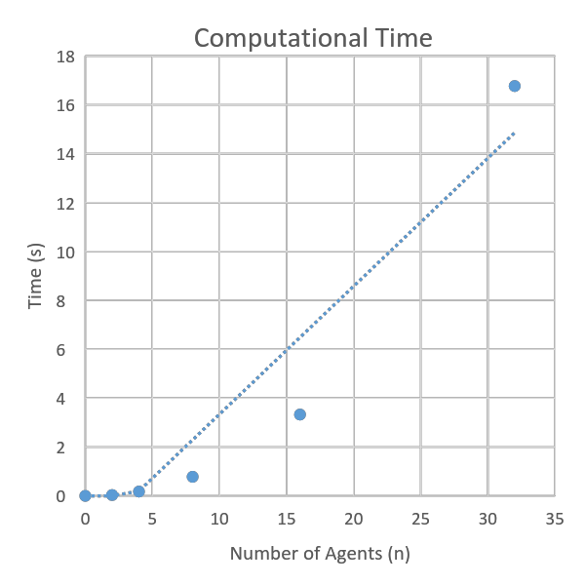
2D Evaluation

Slide 9
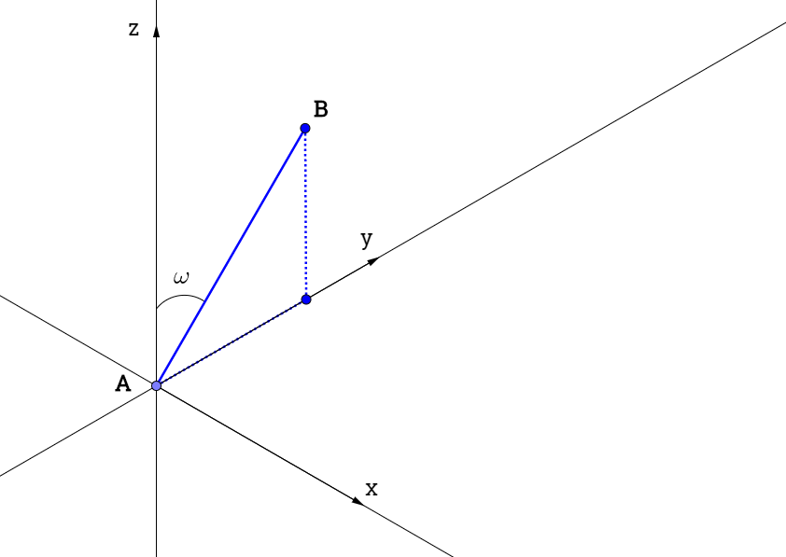
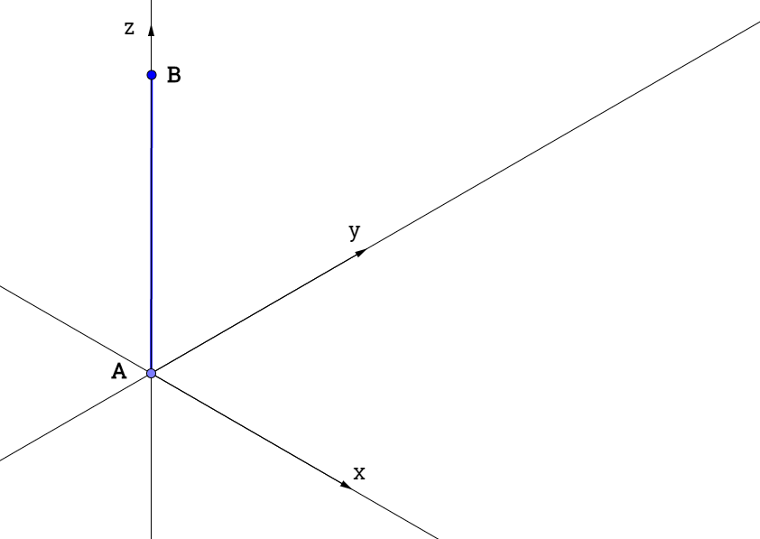
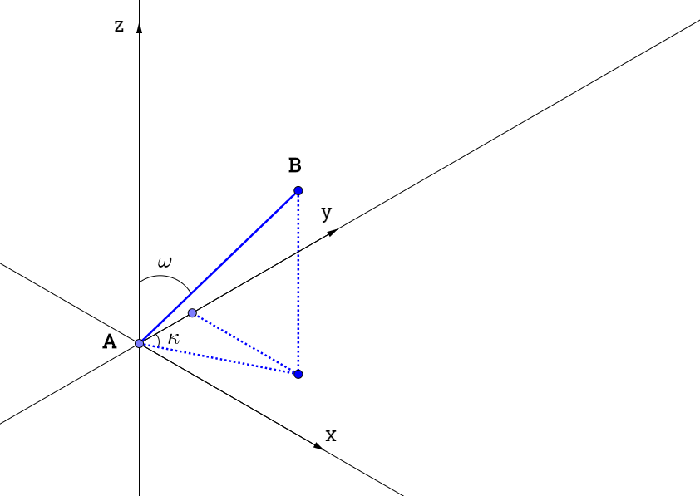
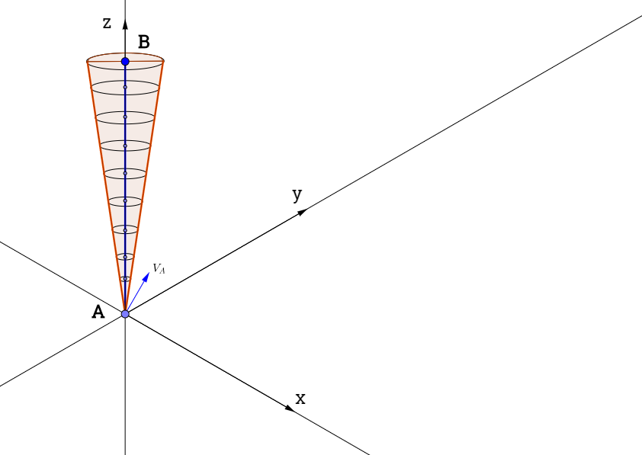
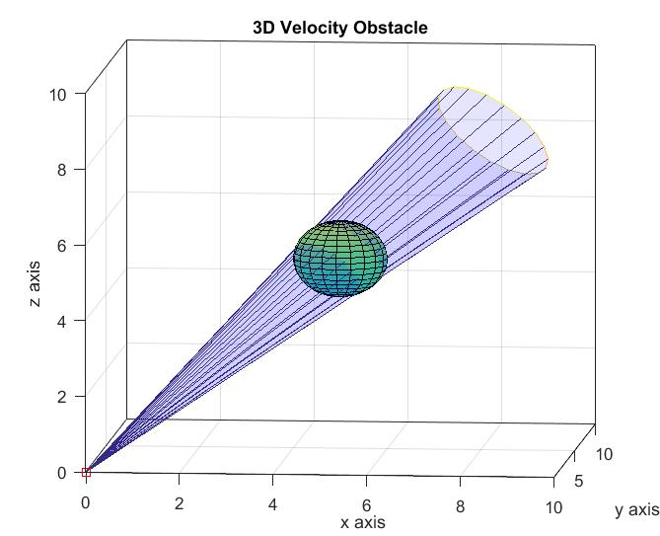
3D Velocity Obstacle

Slide 10
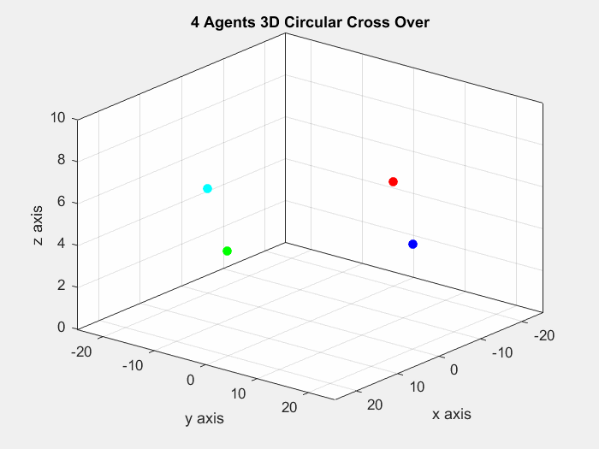
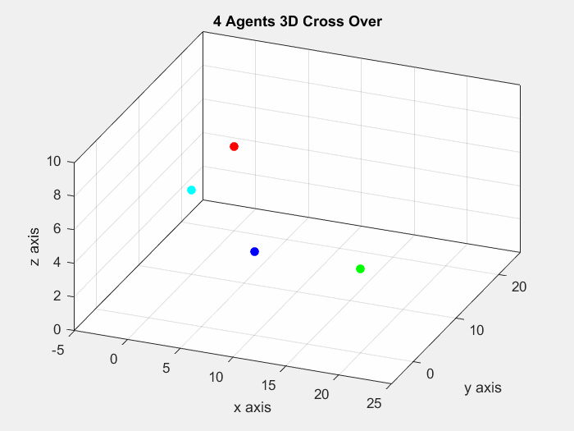
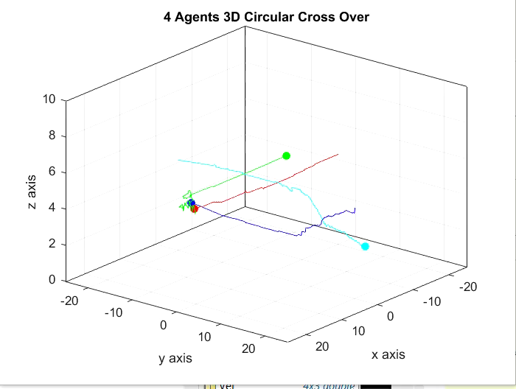
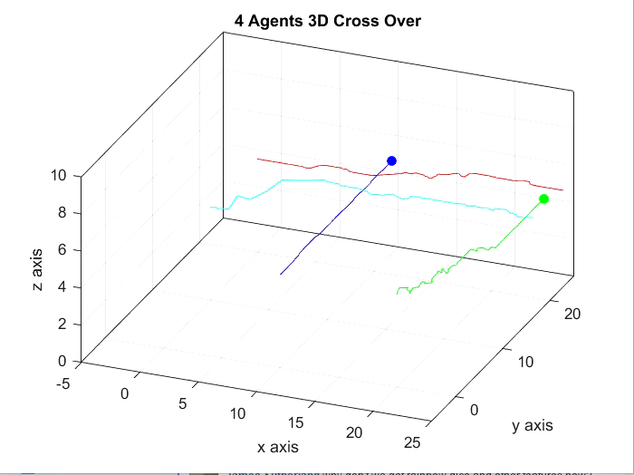
3D Validation

Slide 11
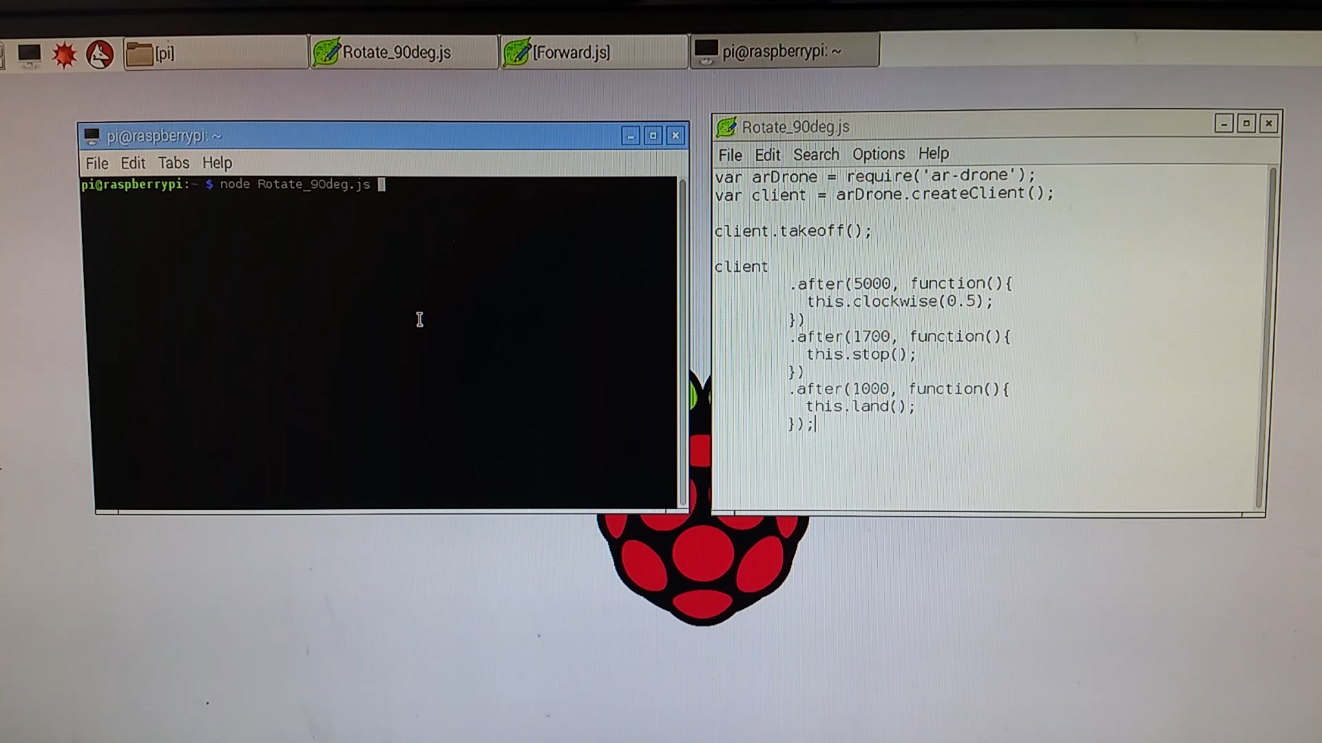
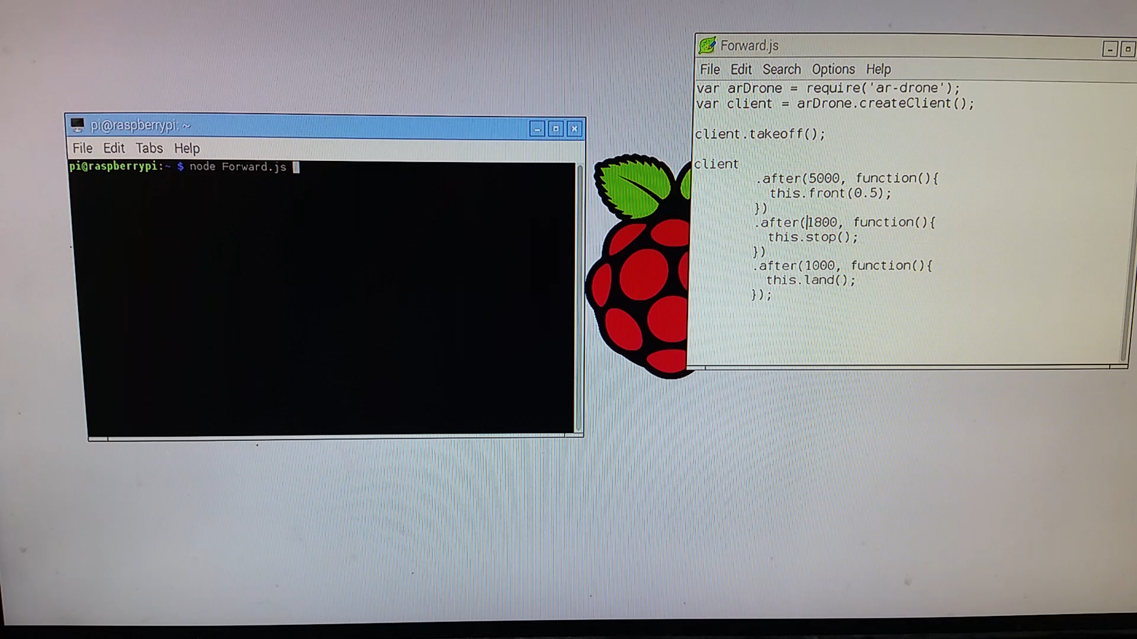
ARDrone
Turn 90 Degrees
Forward 2m

Slide 12
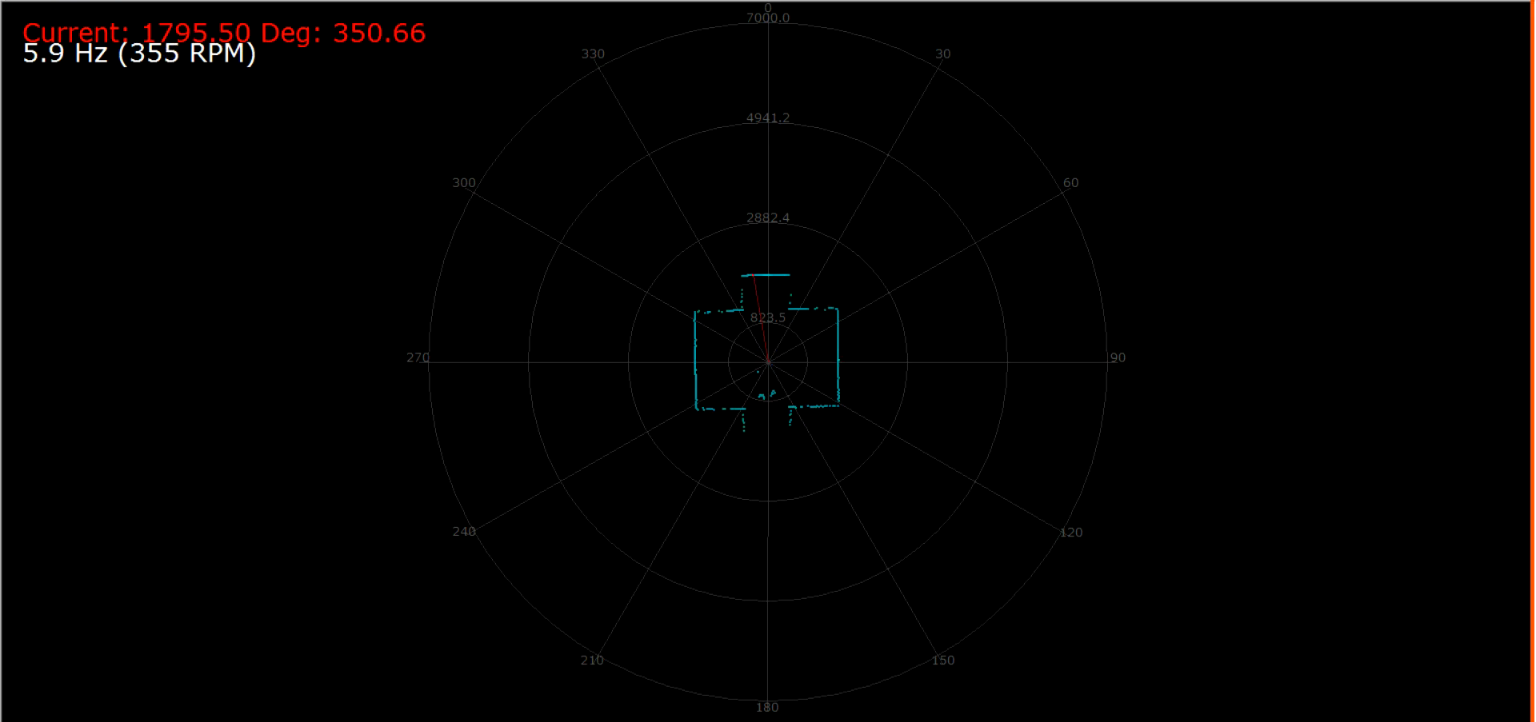
RPLIDAR

Slide 13
Future Work
Develop Algorithms to provide smoother responses
Add constraints to the Algorithms
Implement onto a UAV

Slide 14
Conclusion
Created 2D and 3D CAS using VO
Experimented with the ARDrone and RPLIDAR
Using this work to create a paper on Collision Avoidance Using Velocity Obstacle Trajectories
Thank you to Mila and James for helping me on this journey

